Slide 1
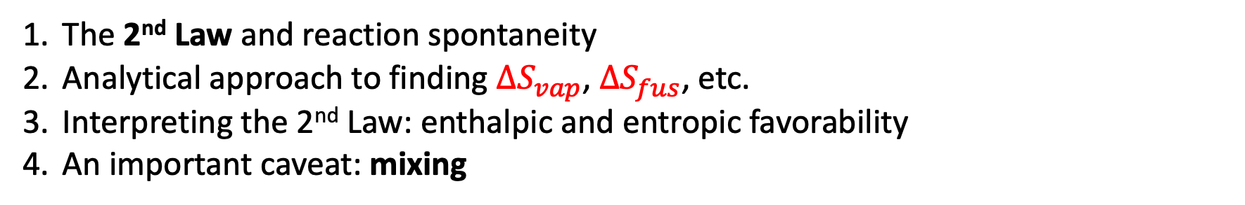
Scope of today’s work
The 2nd Law and reaction spontaneity
Analytical approach to finding $∆S_{vap}$, $∆S_{fus}$, etc.
Interpreting the 2nd Law: enthalpic and entropic favorability
An important caveat: mixing

Slide 2
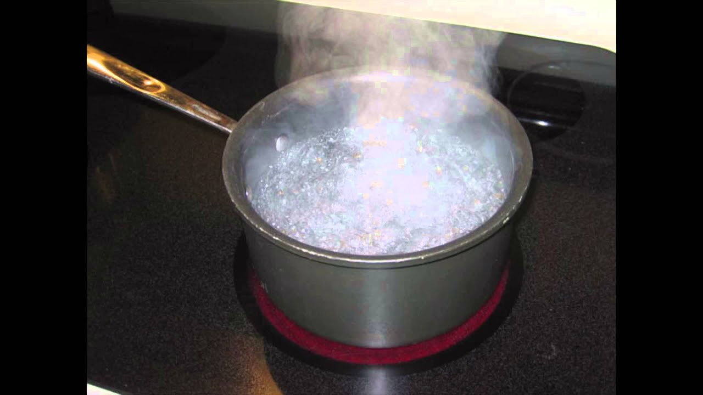

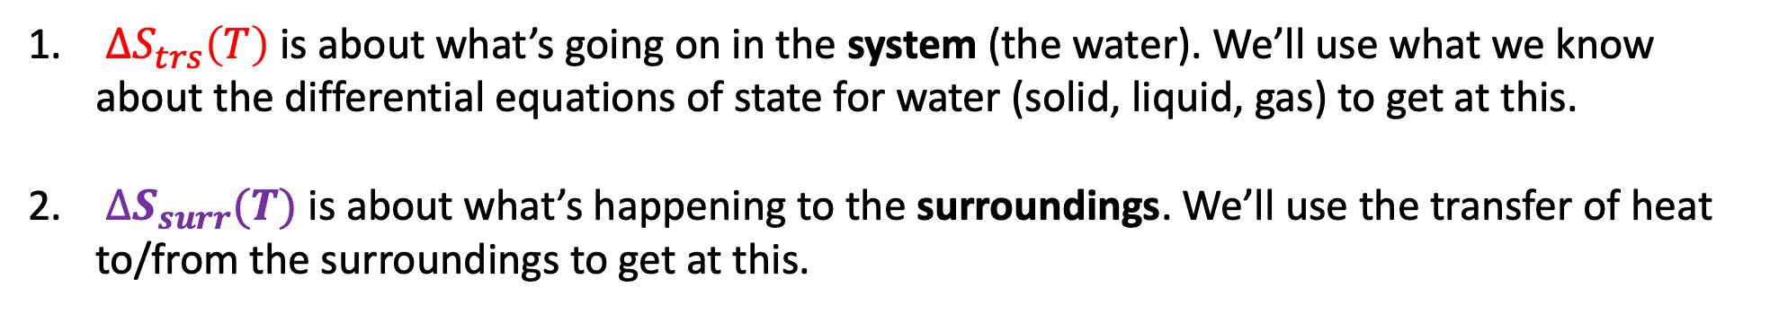
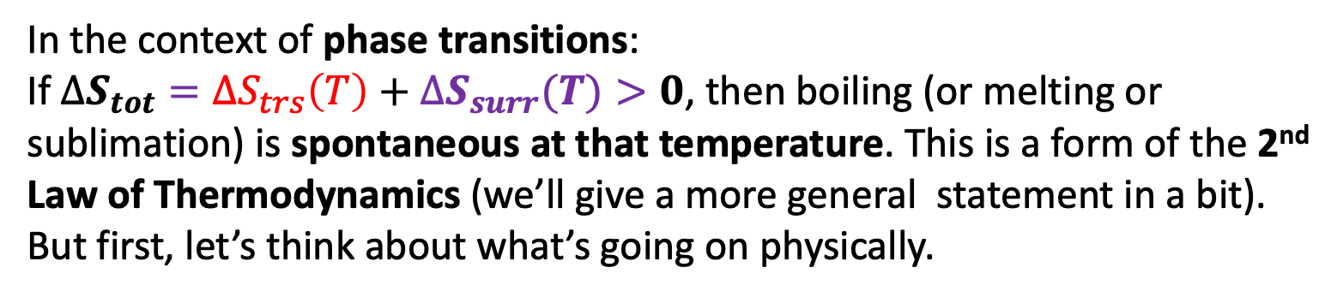
2nd Law of Thermodynamics
In the context of phase transitions:
If $∆S_{tot}={∆S}_{trs}\left(T\right)+∆S_{surr}(T)>0$, then boiling (or melting or sublimation) is spontaneous at that temperature. This is a form of the 2nd Law of Thermodynamics (we’ll give a more general statement in a bit). But first, let’s think about what’s going on physically.
-$109$
${∆S}_{trs}\left(T\right)$ is about what’s going on in the system (the water). We’ll use what we know about the differential equations of state for water (solid, liquid, gas) to get at this.
$∆S_{surr}(T)$ is about what’s happening to the surroundings. We’ll use the transfer of heat to/from the surroundings to get at this.

Slide 3
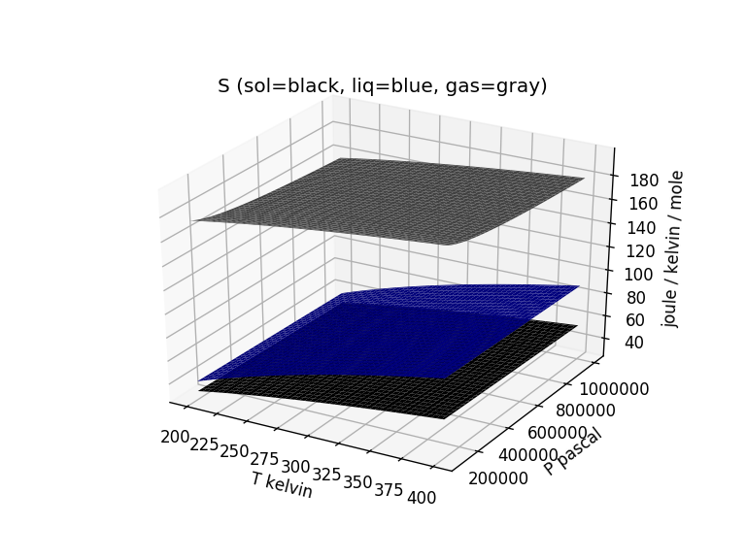


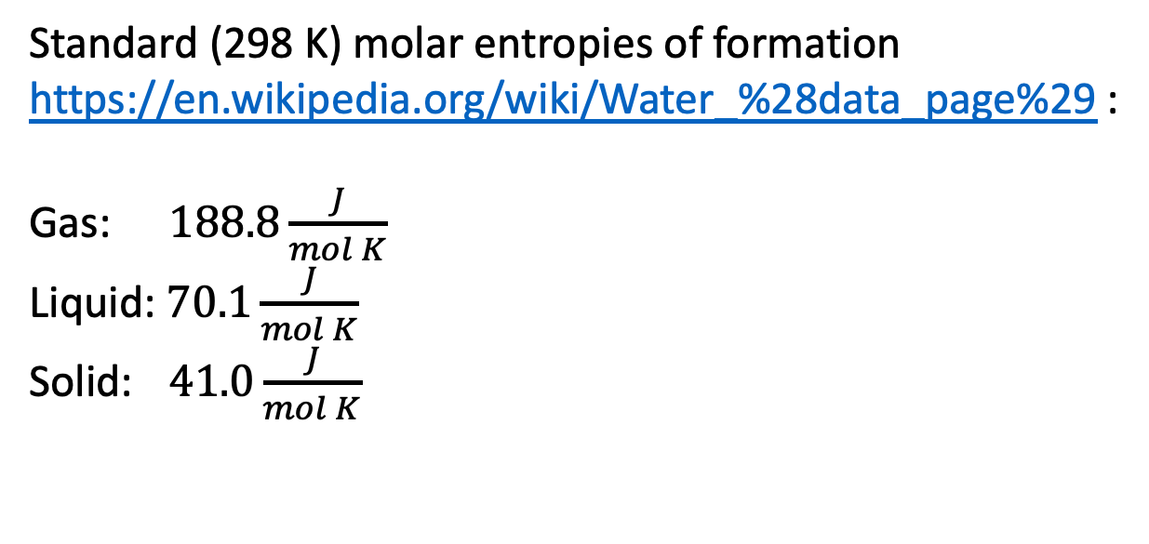

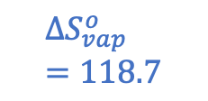

Entropy change of the system: $∆S_{vap}$ at the standard-state temperature (298 K)
Standard (298 K) molar entropies of formation https://en.wikipedia.org/wiki/Water_%28data_page%29 :
Gas: $188.8\frac{J}{mol K}$
Liquid: $70.1\frac{J}{mol K}$
Solid: $41.0\frac{J}{mol K}$
$$188.8$$
$${∆S}_{vap}^{o}=118.7$$
$$∆S_{vap}^{o}=118.7 \frac{J}{mol K}$$
$$70.1$$
$$41.0$$

Slide 4
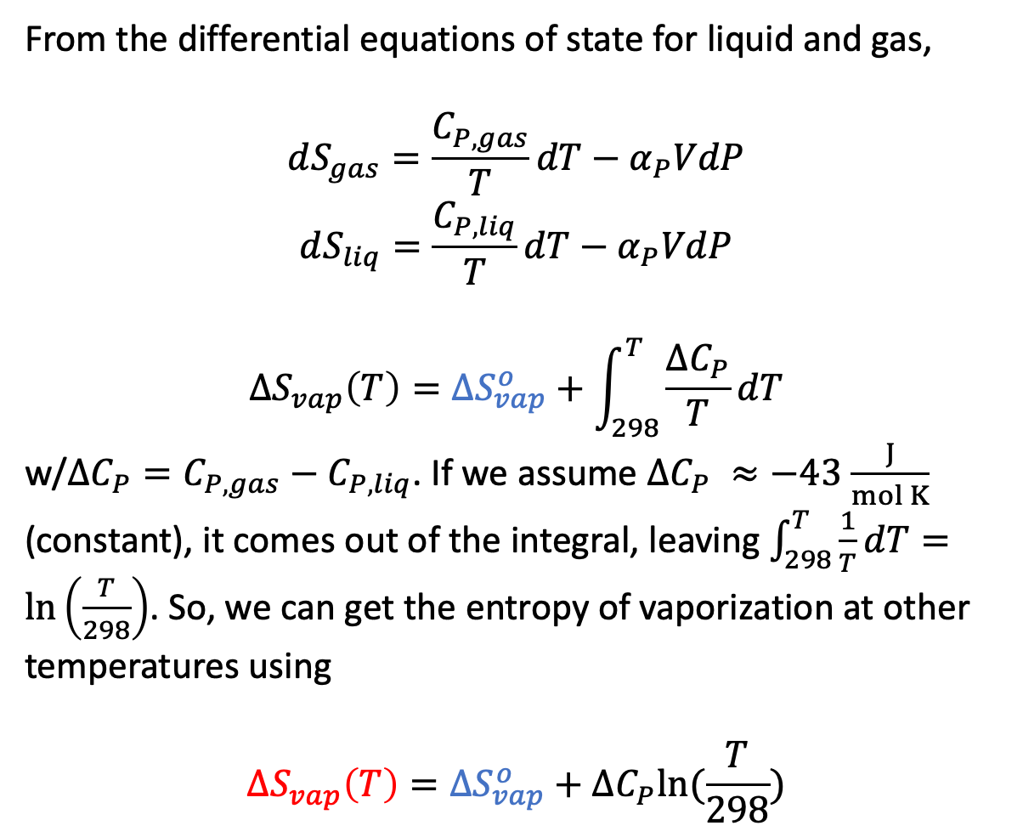

Entropy change of the system: $∆S_{vap}$ at other temperatures
From the differential equations of state for liquid and gas,
$$dS_{gas}=\frac{C_{P,gas}}{T}dT−α_{P}VdP$$
$$dS_{liq}=\frac{C_{P,liq}}{T}dT−α_{P}VdP$$
$${∆S}_{vap}\left(T\right)={∆S}_{vap}^{o}+\int_{298}^{T}{\frac{∆C_{P}}{T}dT}$$
w/$∆C_{P}=C_{P,gas}−C_{P,liq}$. If we assume $∆C_{P} ≈−43$ $\frac{J}{mol K}$ (constant), it comes out of the integral, leaving $\int_{298}^{T}{\frac{1}{T}dT}=\ln\left(\frac{T}{298}\right)$. So, we can get the entropy of vaporization at other temperatures using
$${∆S}_{vap}\left(T\right)={∆S}_{vap}^{o}+∆C_{P}ln⁡(\frac{T}{298})$$
$${∆S}_{vap}^{o}=118.7$$
$$109$$

Slide 5
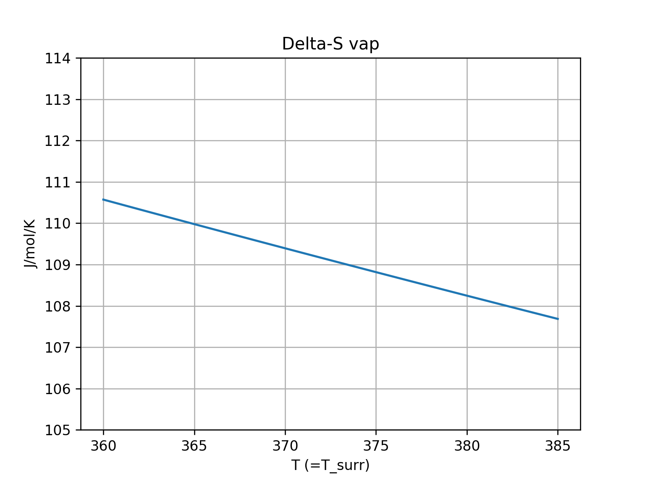
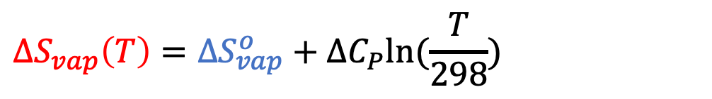
Entropy change of the system: $∆S_{vap}$ at other temperatures
$${∆S}_{vap}\left(T\right)={∆S}_{vap}^{o}+∆C_{P}ln⁡(\frac{T}{298})$$
$${∆S}_{vap}^{o}=118.7$$
$$109$$
slopes down gently
$${∆S}_{vap}\left(373 K\right)=109$$

Slide 6
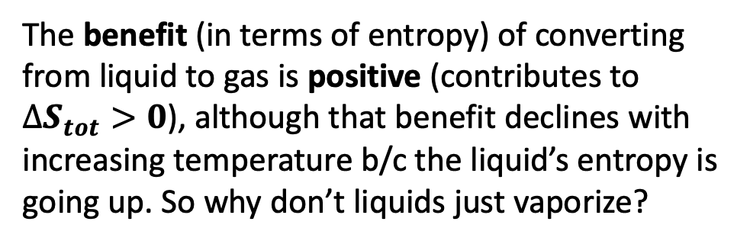
Entropy change of the system: cost-benefit analysis
$${∆S}_{vap}\left(T\right)={∆S}_{vap}^{o}+∆C_{P}ln⁡(\frac{T}{298})$$
$${∆S}_{vap}^{o}=118.7$$
$$109$$
slopes down gently
$${∆S}_{vap}\left(373 K\right)=109$$
The benefit (in terms of entropy) of converting from liquid to gas is positive (contributes to $∆S_{tot}>0$), although that benefit declines with increasing temperature b/c the liquid’s entropy is going up. So why don’t liquids just vaporize?

Slide 7
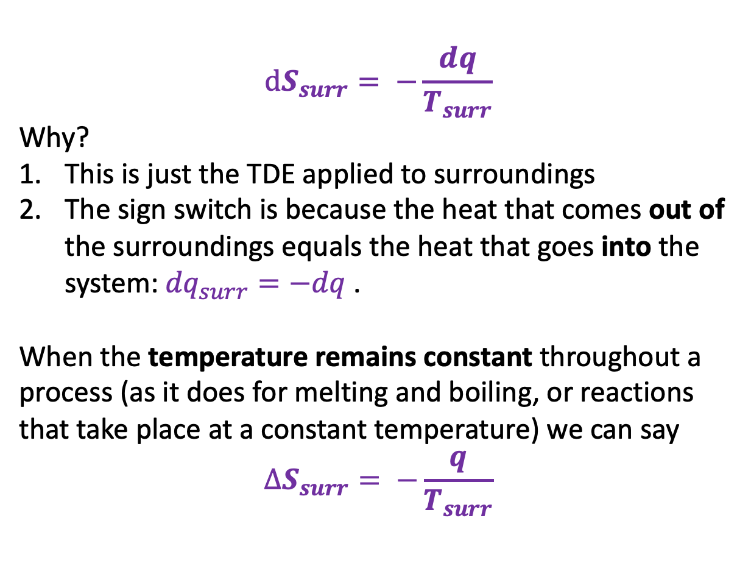
Entropy change of the surroundings: $∆S_{surr}$
$$dS_{surr}= −\frac{dq}{T_{surr}}$$
Why?
This is just the TDE applied to surroundings
The sign switch is because the heat that comes out of the surroundings equals the heat that goes into the system: ${dq}_{surr}=−dq$.
When the temperature remains constant throughout a process (as it does for melting and boiling, or reactions that take place at a constant temperature) we can say
$$∆S_{surr}= −\frac{q}{T_{surr}}$$
We can take this one step farther, knowing that $q=∆H$ for a constant-pressure process, we can say $∆S_{surr}= −\frac{∆H}{T_{surr}}$.

Slide 8
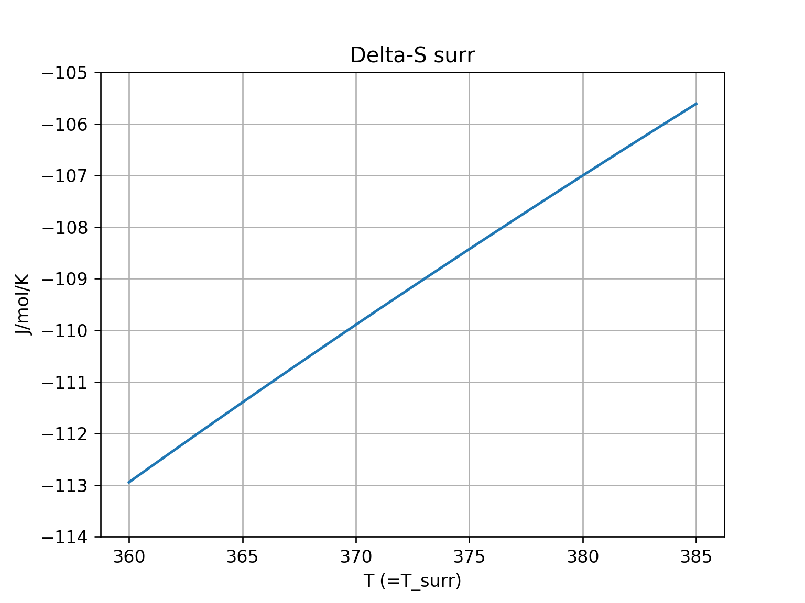



Entropy change of the surroundings: $∆S_{surr}$
$∆S_{surr}(T)= −\frac{∆H_{vap}}{T_{surr}}$
$$T_{surr}$$
-$109$

Slide 9
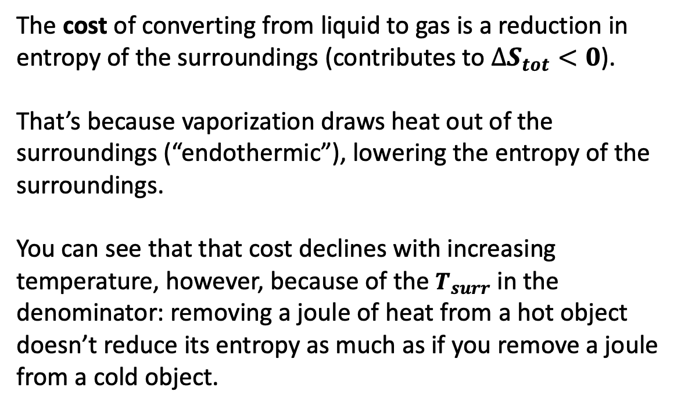
Entropy change of the surroundings: cost/benefit analysis
$∆S_{surr}(T)= −\frac{∆H_{vap}}{T_{surr}}$
The cost of converting from liquid to gas is a reduction in entropy of the surroundings (contributes to $∆S_{tot}<0$).
That’s because vaporization draws heat out of the surroundings (“endothermic”), lowering the entropy of the surroundings.
You can see that that cost declines with increasing temperature, however, because of the $T_{surr}$ in the denominator: removing a joule of heat from a hot object doesn’t reduce its entropy as much as if you remove a joule from a cold object.
$$T_{surr}$$
-$109$

Slide 10


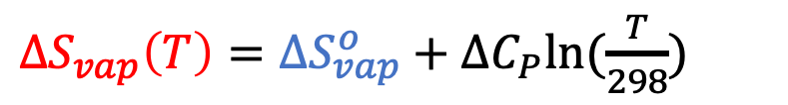
Total entropy change
$∆S_{surr}(T)= −\frac{∆H_{vap}}{T_{surr}}$
${∆S}_{vap}\left(T\right)={∆S}_{vap}^{o}+∆C_{P}ln⁡(\frac{T}{298})$
Rapidly declining cost
Slowly declining benefit
$$T_{surr}$$
$$T$$
$$109$$
-$109$

Slide 11
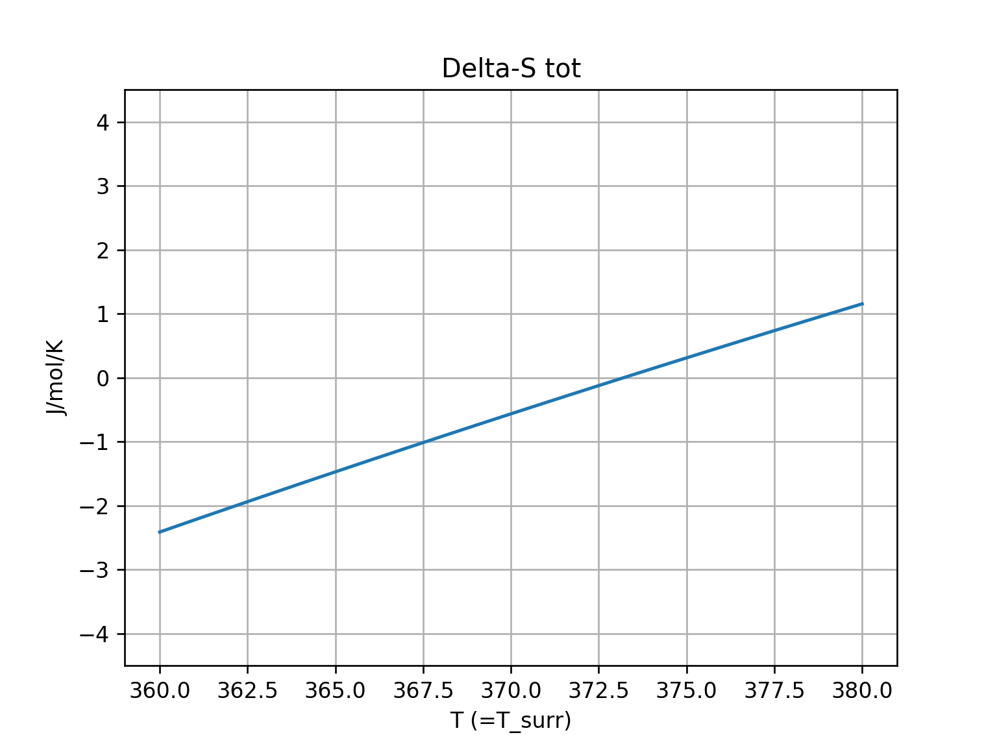

Total entropy change: $∆S_{tot}={∆S}_{vap}\left(T\right)+∆S_{surr}$
$∆S_{surr}(T)= −\frac{∆H_{vap}}{T_{surr}}$
${∆S}_{vap}\left(T\right)={∆S}_{vap}^{o}+∆C_{P}ln⁡(\frac{T}{298})$
Rapidly declining cost
Slowly declining benefit
$$∆S_{tot}={∆S}_{vap}\left(T\right)+∆S_{surr}$$
$$T_{surr}$$
$$T$$
$$109$$
-$109$
$${T=T}_{surr}$$
$${T=T}_{surr}$$

Slide 12
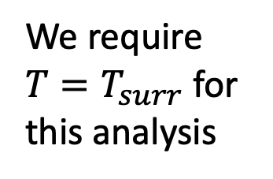
Total entropy change: $∆S_{tot}={∆S}_{vap}\left(T\right)+∆S_{surr}$
$∆S_{surr}(T)= −\frac{∆H_{vap}}{T_{surr}}$
${∆S}_{vap}\left(T\right)={∆S}_{vap}^{o}+∆C_{P}ln⁡(\frac{T}{298})$
Rapidly declining cost
Slowly declining benefit
$$∆S_{tot}={∆S}_{vap}\left(T\right)+∆S_{surr}$$
$$T_{surr}$$
$$T$$
We require $T=T_{surr}$ for this analysis
$$109$$
-$109$
$${T=T}_{surr}$$
$${T=T}_{surr}$$

Slide 13
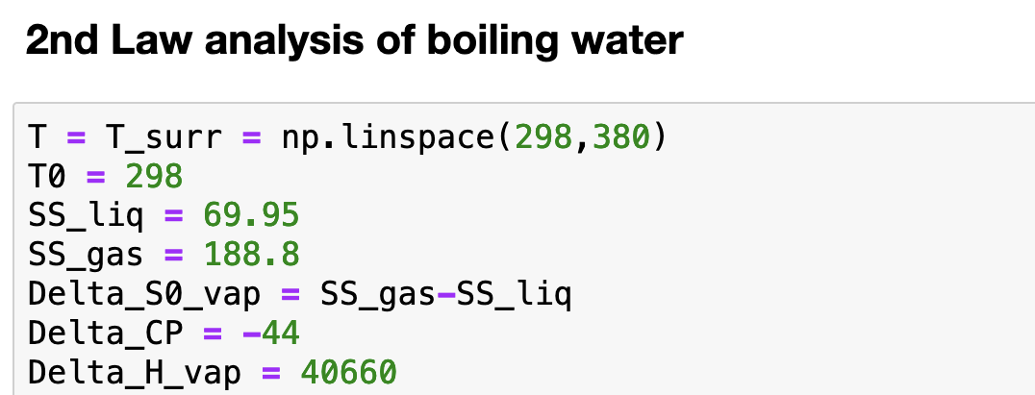
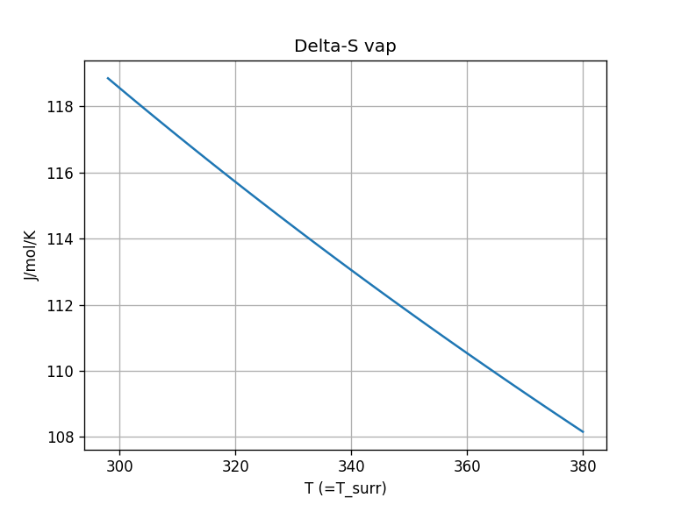
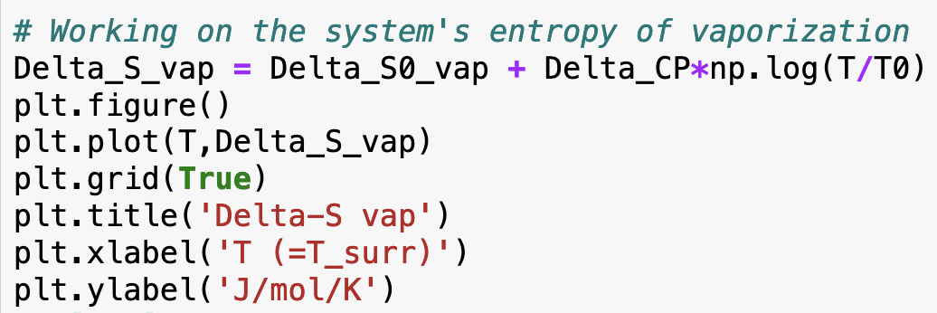
How we could do that in Python

Slide 14
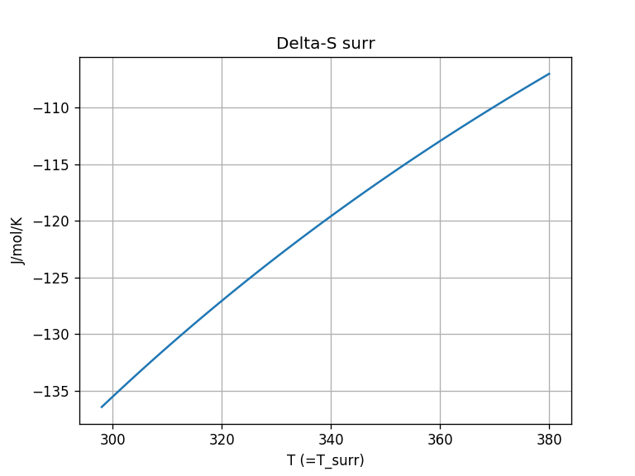
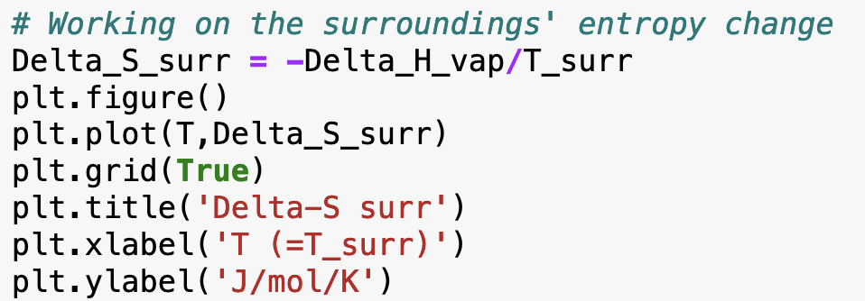
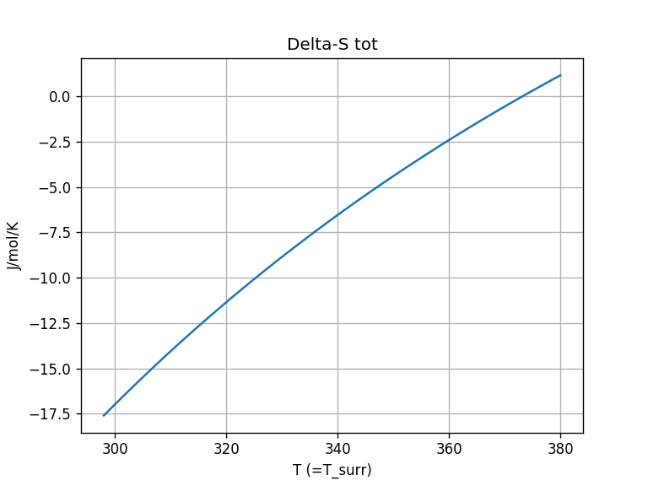
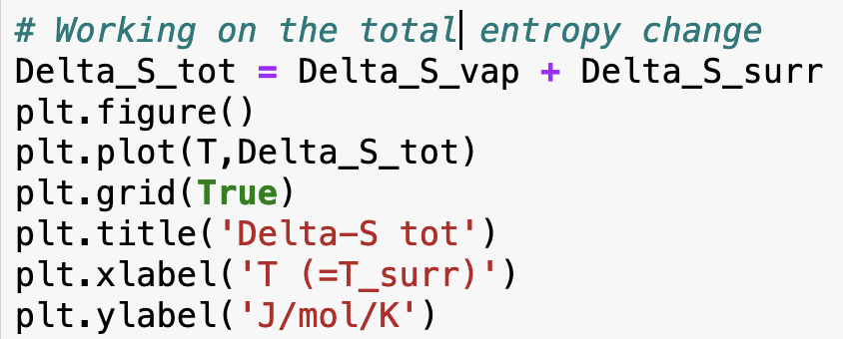
How we could do that in Python

Slide 15
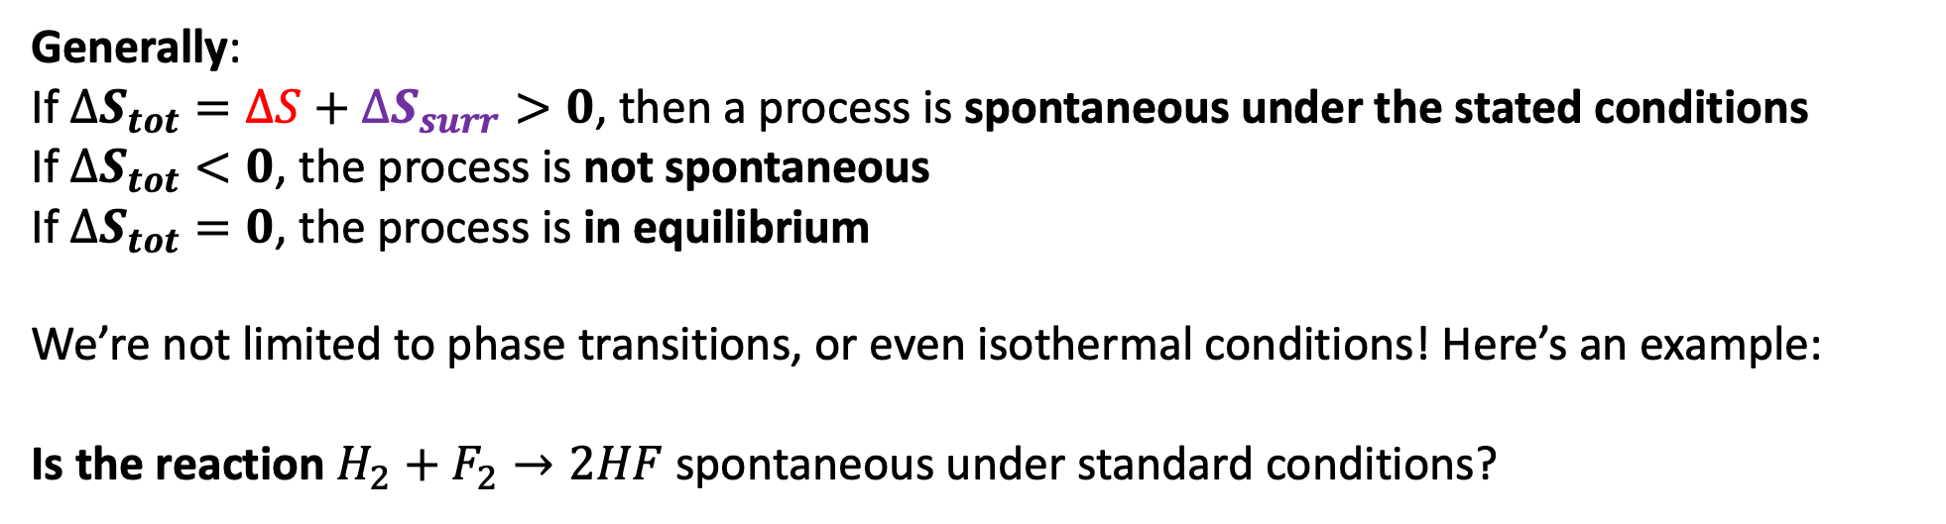
A more general statement of the 2nd Law of thermodynamics
Generally:
If $∆S_{tot}=∆S+∆S_{surr}>0$, then a process is spontaneous under the stated conditions
If $∆S_{tot}<0$, the process is not spontaneous
If $∆S_{tot}=0$, the process is in equilibrium
We’re not limited to phase transitions, or even isothermal conditions! Here’s an example:
Is the reaction $H_{2}+F_{2}→2HF$ spontaneous under standard conditions?
-$109$

Slide 16
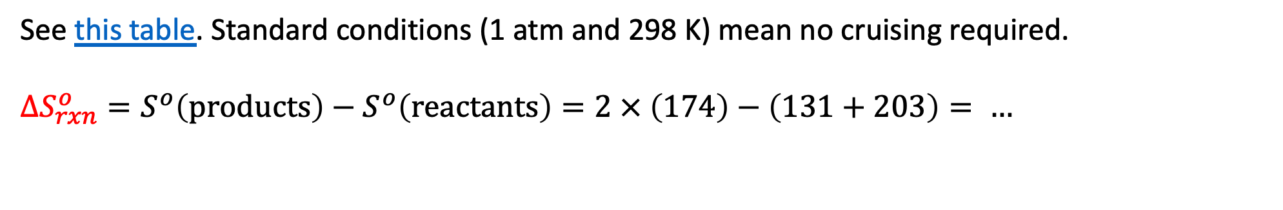
Thermodynamics of the reaction $H_{2}+F_{2}→2HF$
See this table. Standard conditions (1 atm and 298 K) mean no cruising required.
$$∆S_{rxn}^{o}=S^{o}\left(products\right)−S^{o}\left(reactants\right)=2 × \left(174\right)−\left(131+203\right)= …$$

Slide 17
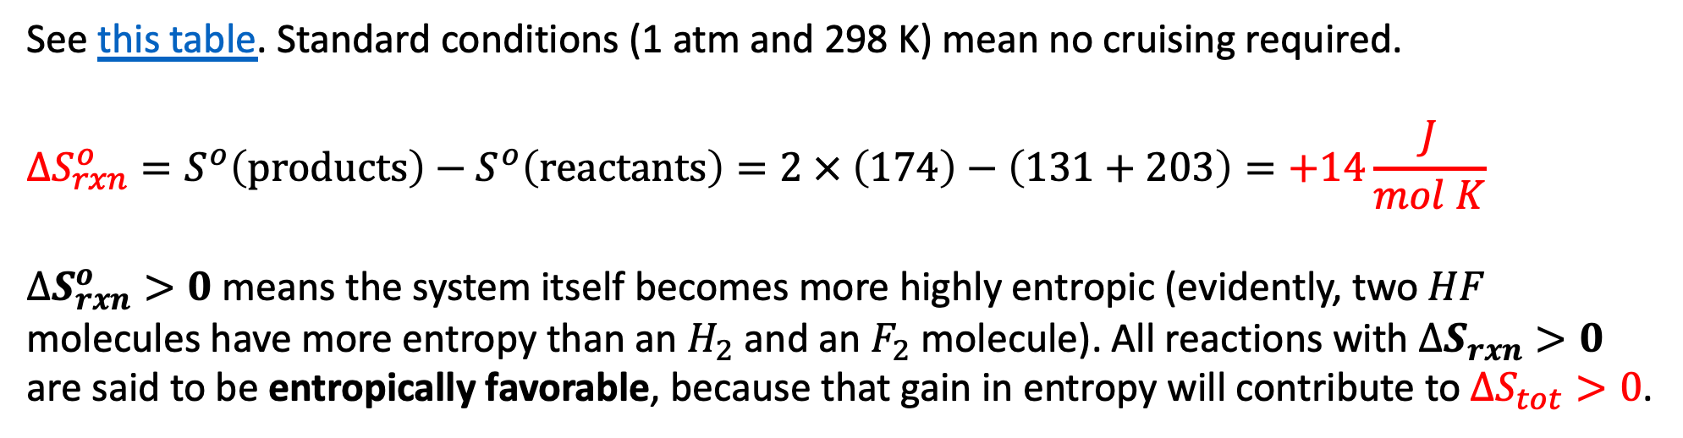
Thermodynamics of the reaction $H_{2}+F_{2}→2HF$
See this table. Standard conditions (1 atm and 298 K) mean no cruising required.
$$∆S_{rxn}^{o}=S^{o}\left(products\right)−S^{o}\left(reactants\right)=2 × \left(174\right)−\left(131+203\right)=+14\frac{J}{mol K}$$
$∆S_{rxn}^{o}>0$ means the system itself becomes more highly entropic (evidently, two $HF$ molecules have more entropy than an $H_{2}$ and an $F_{2}$ molecule). All reactions with $∆S_{rxn}>0$ are said to be entropically favorable, because that gain in entropy will contribute to $∆S_{tot}>0$.

Slide 18
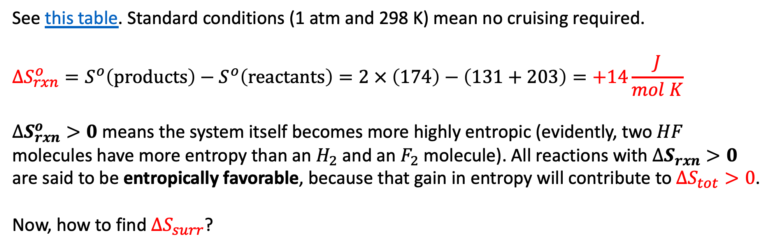
Thermodynamics of the reaction $H_{2}+F_{2}→2HF$
See this table. Standard conditions (1 atm and 298 K) mean no cruising required.
$$∆S_{rxn}^{o}=S^{o}\left(products\right)−S^{o}\left(reactants\right)=2 × \left(174\right)−\left(131+203\right)=+14\frac{J}{mol K}$$
$∆S_{rxn}^{o}>0$ means the system itself becomes more highly entropic (evidently, two $HF$ molecules have more entropy than an $H_{2}$ and an $F_{2}$ molecule). All reactions with $∆S_{rxn}>0$ are said to be entropically favorable, because that gain in entropy will contribute to $∆S_{tot}>0$.
Now, how to find $∆S_{surr}$?

Slide 19
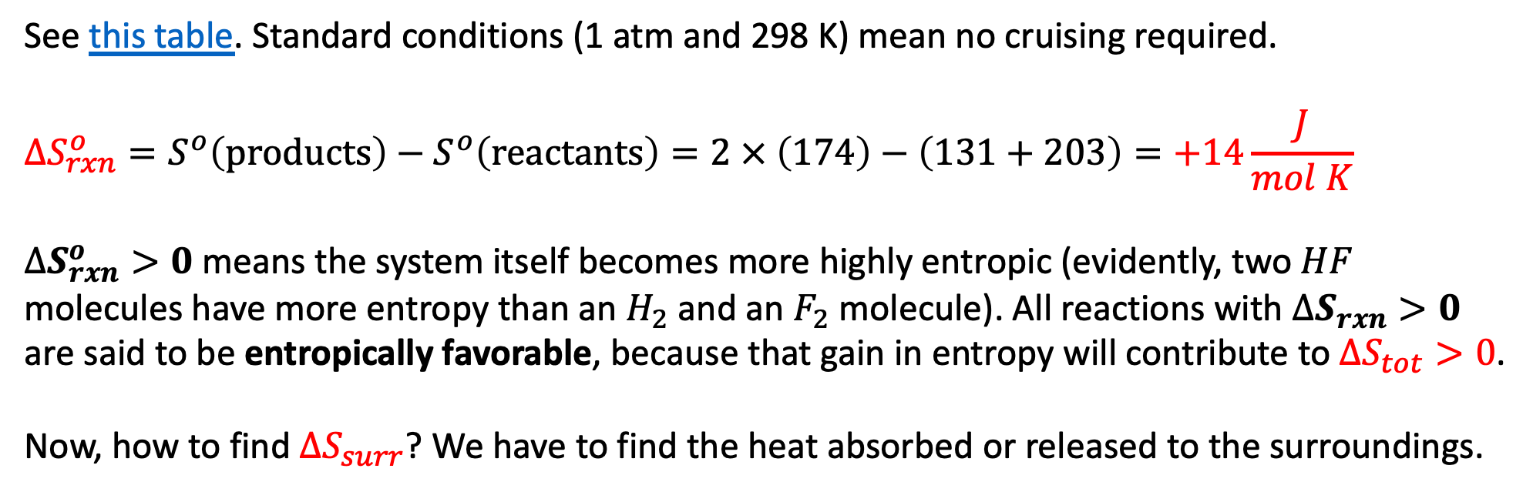
Thermodynamics of the reaction $H_{2}+F_{2}→2HF$
See this table. Standard conditions (1 atm and 298 K) mean no cruising required.
$$∆S_{rxn}^{o}=S^{o}\left(products\right)−S^{o}\left(reactants\right)=2 × \left(174\right)−\left(131+203\right)=+14\frac{J}{mol K}$$
$∆S_{rxn}^{o}>0$ means the system itself becomes more highly entropic (evidently, two $HF$ molecules have more entropy than an $H_{2}$ and an $F_{2}$ molecule). All reactions with $∆S_{rxn}>0$ are said to be entropically favorable, because that gain in entropy will contribute to $∆S_{tot}>0$.
Now, how to find $∆S_{surr}$? We have to find the heat absorbed or released to the surroundings.

Slide 20
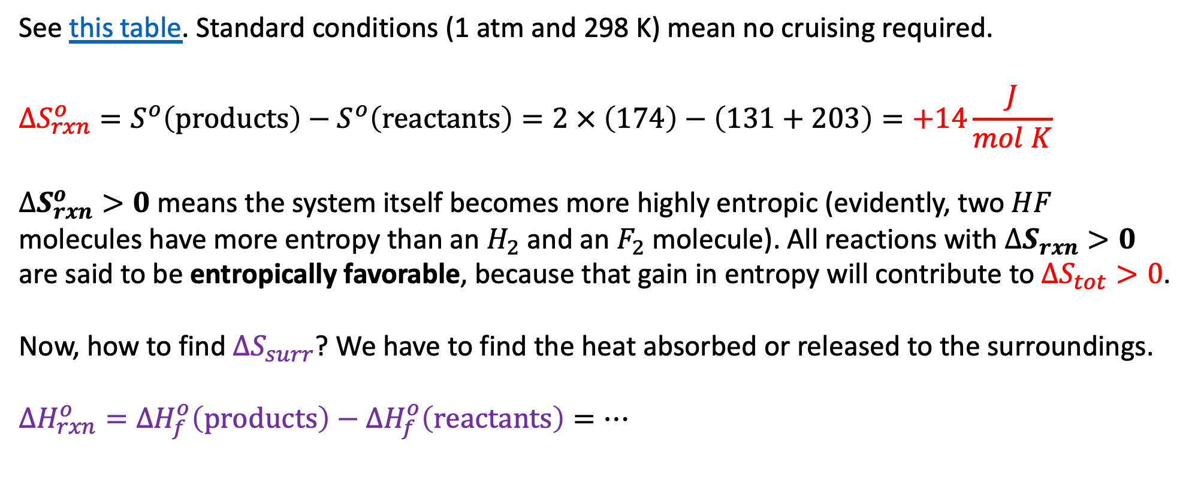
Thermodynamics of the reaction $H_{2}+F_{2}→2HF$
See this table. Standard conditions (1 atm and 298 K) mean no cruising required.
$$∆S_{rxn}^{o}=S^{o}\left(products\right)−S^{o}\left(reactants\right)=2 × \left(174\right)−\left(131+203\right)=+14\frac{J}{mol K}$$
$∆S_{rxn}^{o}>0$ means the system itself becomes more highly entropic (evidently, two $HF$ molecules have more entropy than an $H_{2}$ and an $F_{2}$ molecule). All reactions with $∆S_{rxn}>0$ are said to be entropically favorable, because that gain in entropy will contribute to $∆S_{tot}>0$.
Now, how to find $∆S_{surr}$? We have to find the heat absorbed or released to the surroundings.
$∆H_{rxn}^{o}={∆H}_{f}^{o}\left(products\right)−{∆H}_{f}^{o}\left(reactants\right)=…$

Slide 21
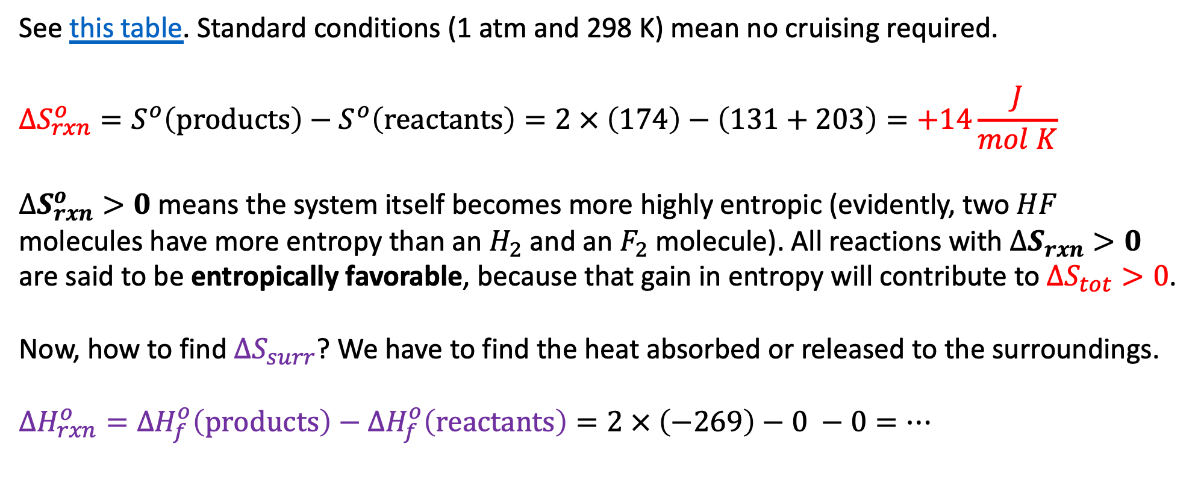
Thermodynamics of the reaction $H_{2}+F_{2}→2HF$
See this table. Standard conditions (1 atm and 298 K) mean no cruising required.
$$∆S_{rxn}^{o}=S^{o}\left(products\right)−S^{o}\left(reactants\right)=2 × \left(174\right)−\left(131+203\right)=+14\frac{J}{mol K}$$
$∆S_{rxn}^{o}>0$ means the system itself becomes more highly entropic (evidently, two $HF$ molecules have more entropy than an $H_{2}$ and an $F_{2}$ molecule). All reactions with $∆S_{rxn}>0$ are said to be entropically favorable, because that gain in entropy will contribute to $∆S_{tot}>0$.
Now, how to find $∆S_{surr}$? We have to find the heat absorbed or released to the surroundings.
$∆H_{rxn}^{o}={∆H}_{f}^{o}\left(products\right)−{∆H}_{f}^{o}\left(reactants\right)=2 × \left(−269\right)−0 −0=…$

Slide 22
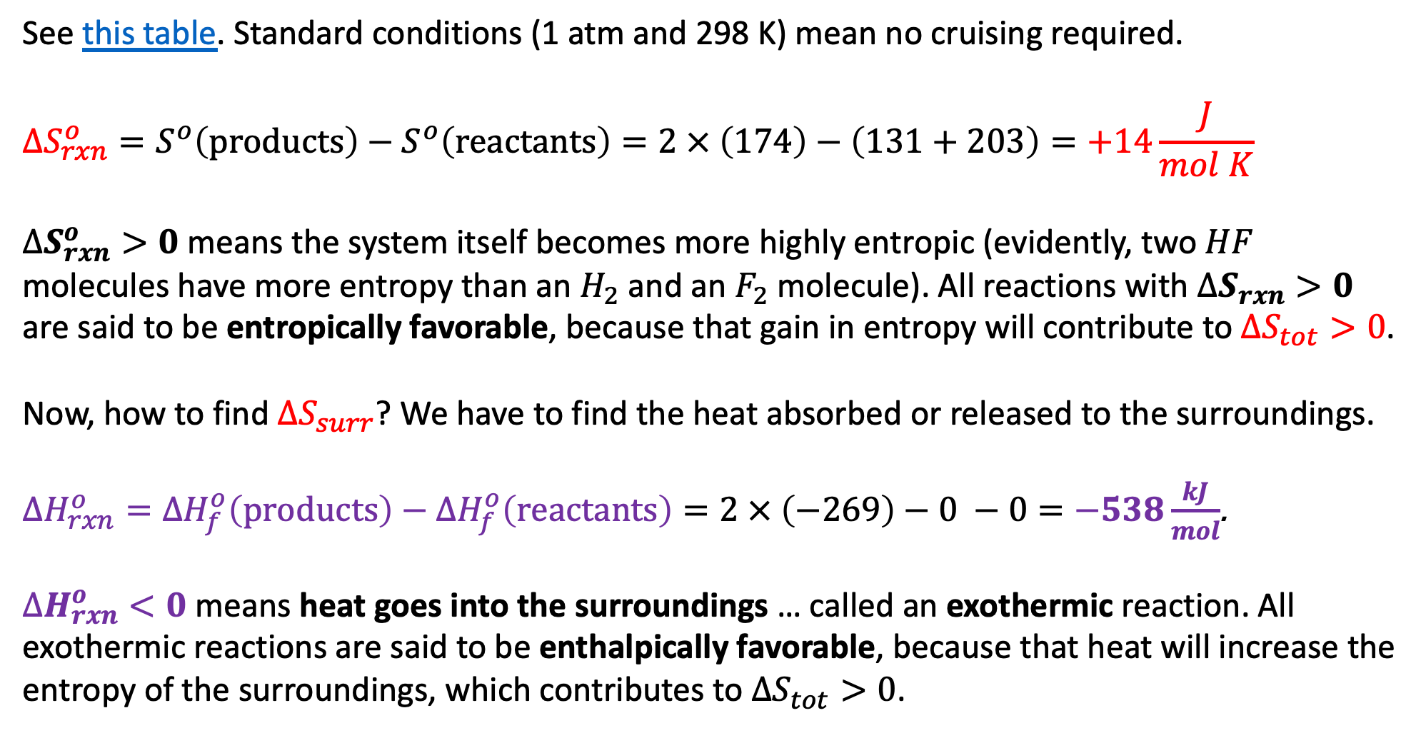
Thermodynamics of the reaction $H_{2}+F_{2}→2HF$
See this table. Standard conditions (1 atm and 298 K) mean no cruising required.
$$∆S_{rxn}^{o}=S^{o}\left(products\right)−S^{o}\left(reactants\right)=2 × \left(174\right)−\left(131+203\right)=+14\frac{J}{mol K}$$
$∆S_{rxn}^{o}>0$ means the system itself becomes more highly entropic (evidently, two $HF$ molecules have more entropy than an $H_{2}$ and an $F_{2}$ molecule). All reactions with $∆S_{rxn}>0$ are said to be entropically favorable, because that gain in entropy will contribute to $∆S_{tot}>0$.
Now, how to find $∆S_{surr}$? We have to find the heat absorbed or released to the surroundings.
$∆H_{rxn}^{o}={∆H}_{f}^{o}\left(products\right)−{∆H}_{f}^{o}\left(reactants\right)=2 × \left(−269\right)−0 −0=−538\frac{kJ}{mol}$.
$∆H_{rxn}^{o}<0$ means heat goes into the surroundings … called an exothermic reaction. All exothermic reactions are said to be enthalpically favorable, because that heat will increase the entropy of the surroundings, which contributes to $∆S_{tot}>0$.

Slide 23
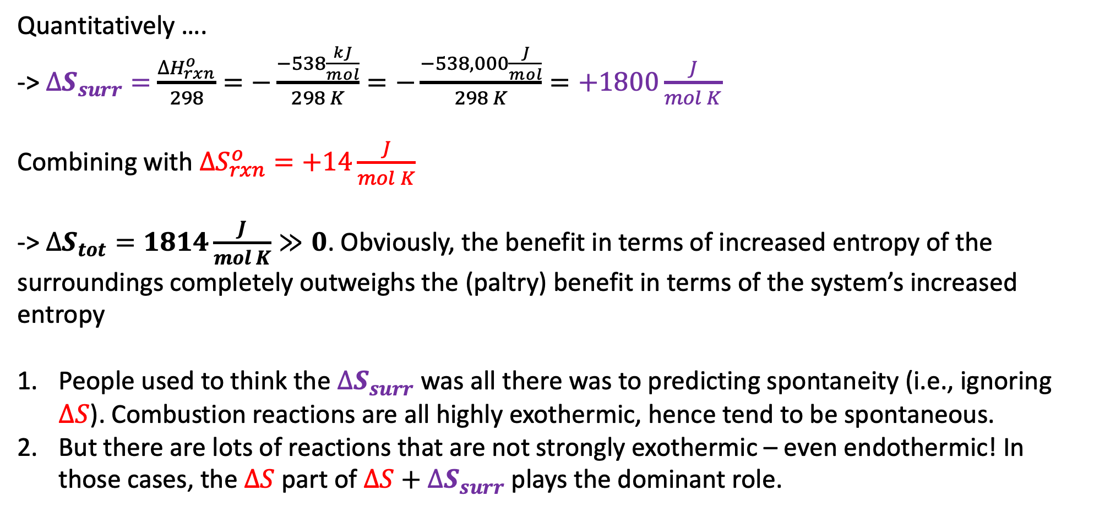
Thermodynamics of the reaction $H_{2}+F_{2}→2HF$
Quantitatively ….
-> $∆S_{surr}=$ $\frac{∆H_{rxn}^{o}}{298}=−\frac{−538\frac{kJ}{mol}}{298 K}=−\frac{−538,000\frac{J}{mol}}{298 K}=+1800\frac{J}{mol K}$
Combining with $∆S_{rxn}^{o}=+14\frac{J}{mol K}$
-> $∆S_{tot}=1814\frac{J}{mol K}≫0$. Obviously, the benefit in terms of increased entropy of the surroundings completely outweighs the (paltry) benefit in terms of the system’s increased entropy
People used to think the $∆S_{surr}$ was all there was to predicting spontaneity (i.e., ignoring $∆S$). Combustion reactions are all highly exothermic, hence tend to be spontaneous.
But there are lots of reactions that are not strongly exothermic – even endothermic! In those cases, the $∆S$ part of $∆S+∆S_{surr}$ plays the dominant role.

Slide 24
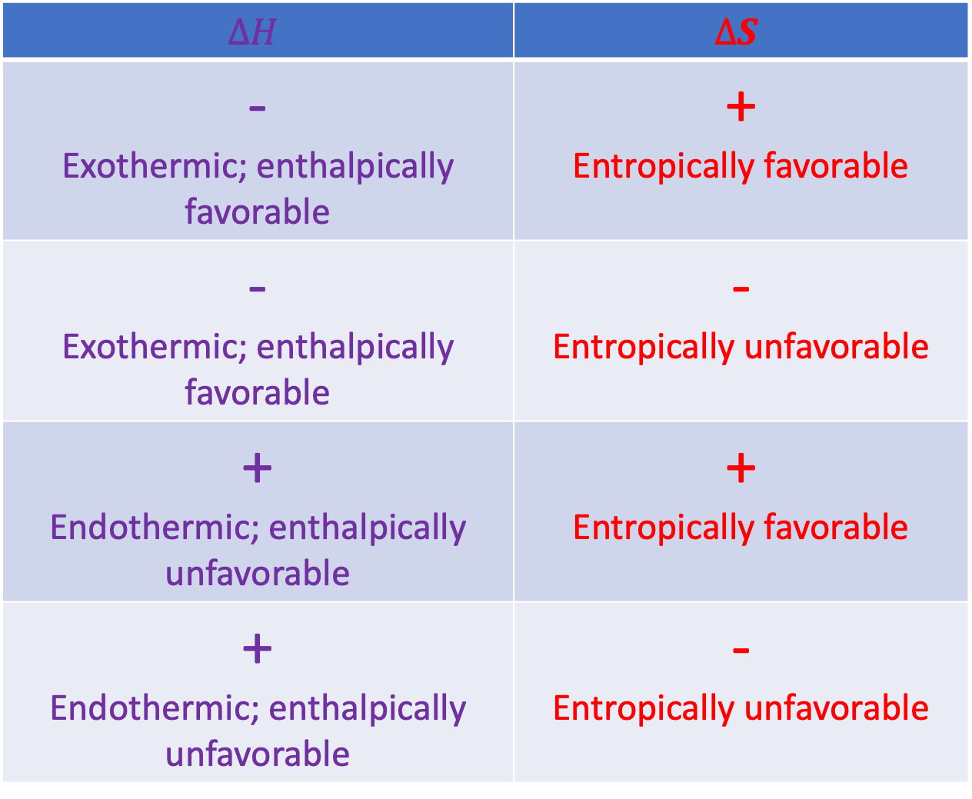
Systematizing the enthalpic/entropic favorability/unfavorability picture
$$∆H$$ | $$∆S$$
- Exothermic; enthalpically favorable | + Entropically favorable
- Exothermic; enthalpically favorable | - Entropically unfavorable
+ Endothermic; enthalpically unfavorable | + Entropically favorable
+ Endothermic; enthalpically unfavorable | - Entropically unfavorable

Slide 25
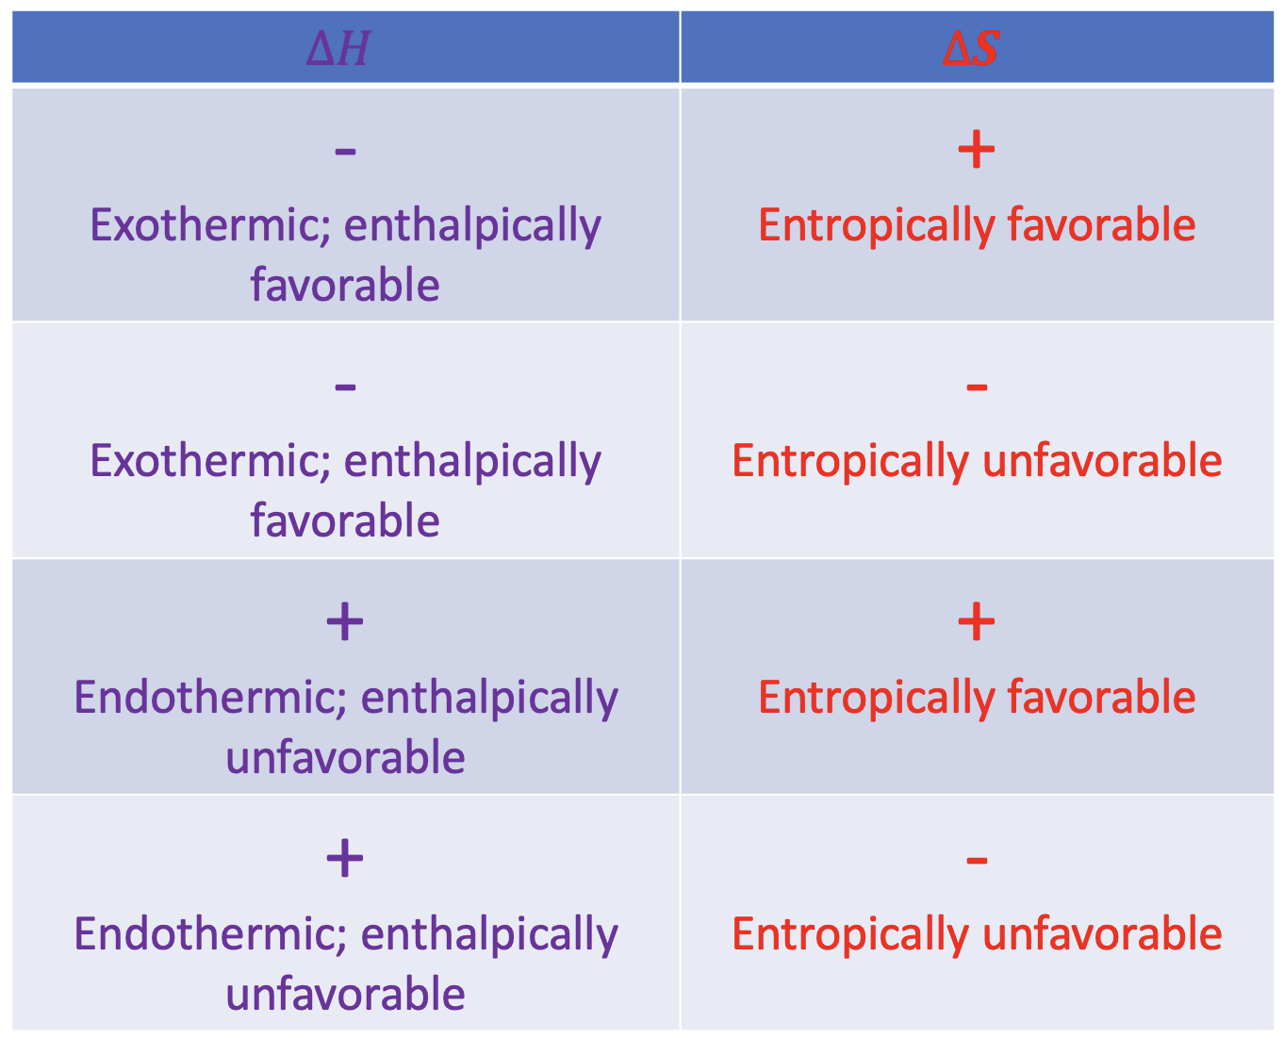
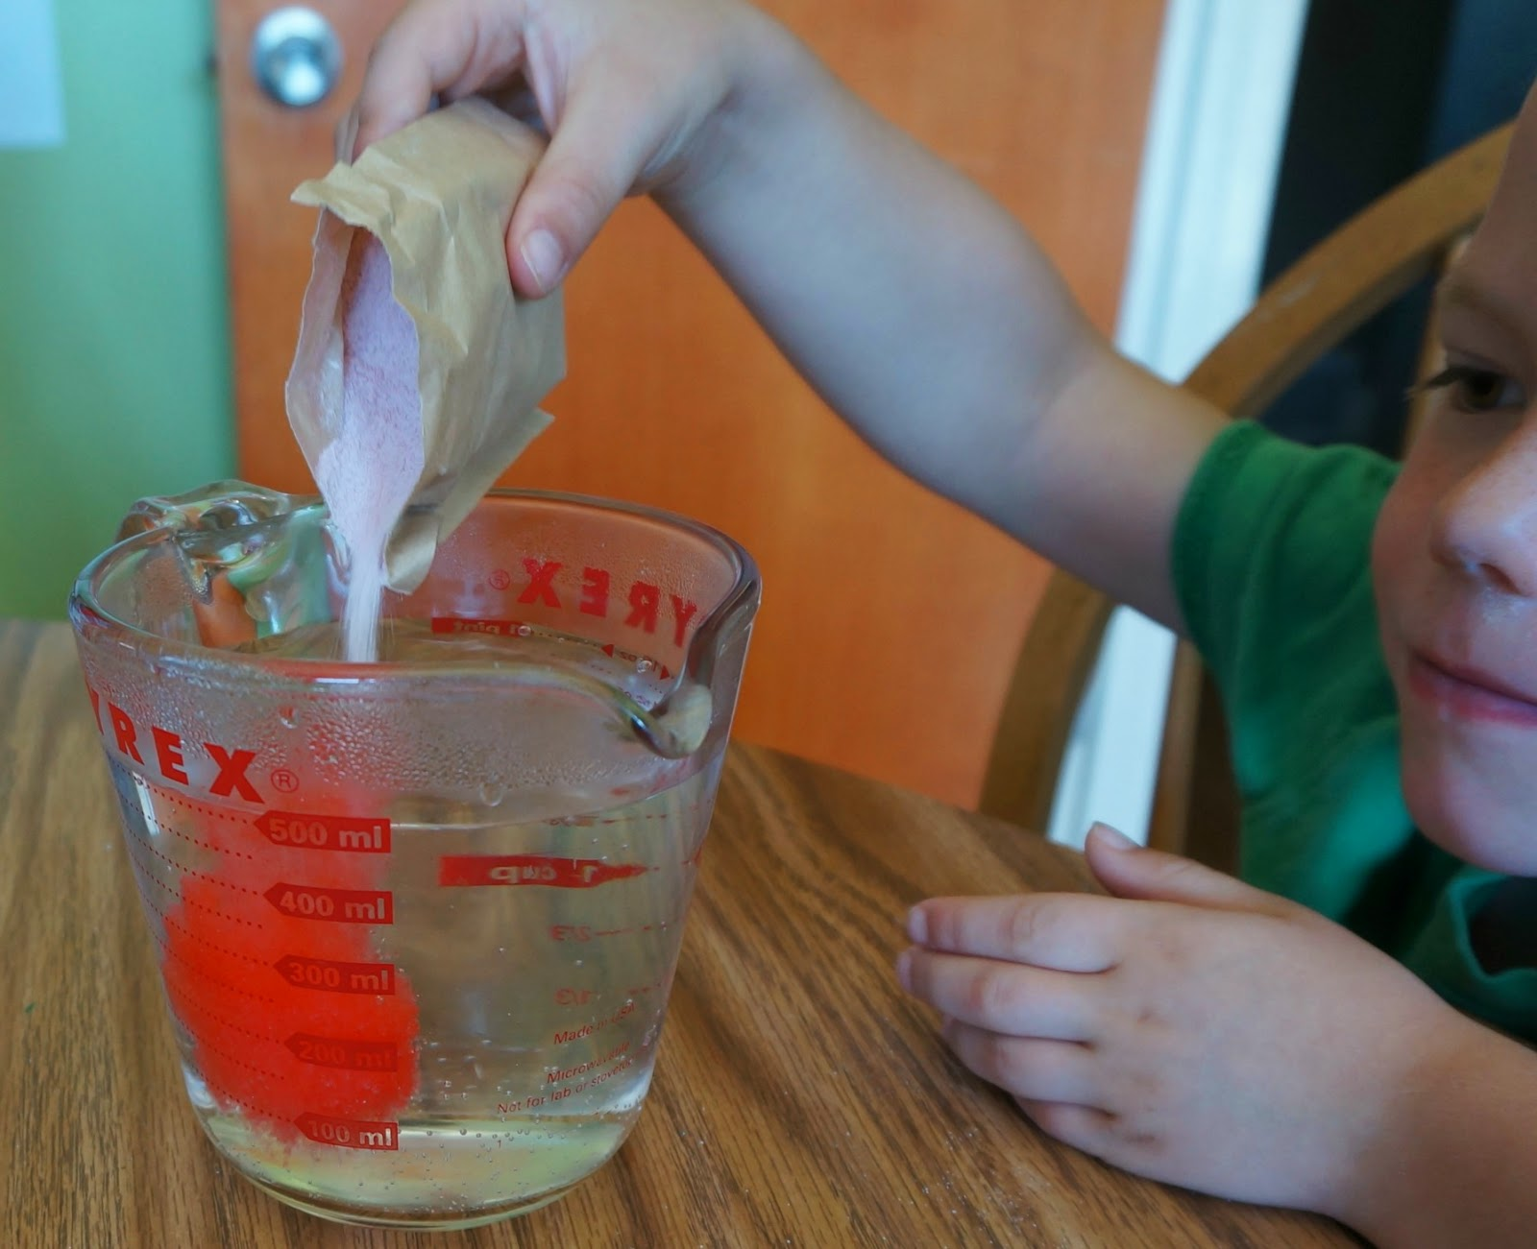










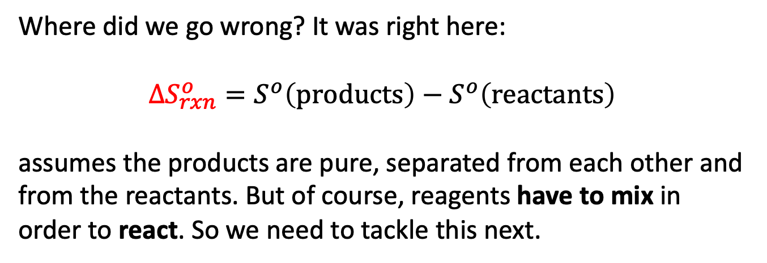


An important caveat: mixing
It turns out that this table omits something really critical. Remember we talked about irreversibility? Irreversibility happens whenever we mix different chemical substances.
Where did we go wrong? It was right here:
$$∆S_{rxn}^{o}=S^{o}\left(products\right)−S^{o}\left(reactants\right)$$
assumes the products are pure, separated from each other and from the reactants. But of course, reagents have to mix in order to react. So we need to tackle this next.
$H_{2}$
$H_{2}$
$H_{2}$
$H_{2}$
$$HF$$
$$F_{2}$$
$$F_{2}$$
$H_{2}$
$$HF$$
$$F_{2}$$
$$F_{2}$$
$$F_{2}$$
$$F_{2}$$

Slide 26
What we learned …
The 2nd Law divides the question of spontaneity into two parts:
A system part that we can get at using differential equations of state for the entropy, and thermodynamic tables of entropy
A surroundings part that deals with the entropy change of the surroundings due to heat transfer, that we can get at using thermodynamic tables of enthalpy
Quantitative treatment lets us predict the temperature dependence of spontaneity
Qualitative interpretation of the 2nd Law: enthalpic and entropic favorability
An important caveat: mixing

